Slide 1
Fabric Data Warehousing
Christian Ømand
Partner Solution Architect, Microsoft DK

Slide 2
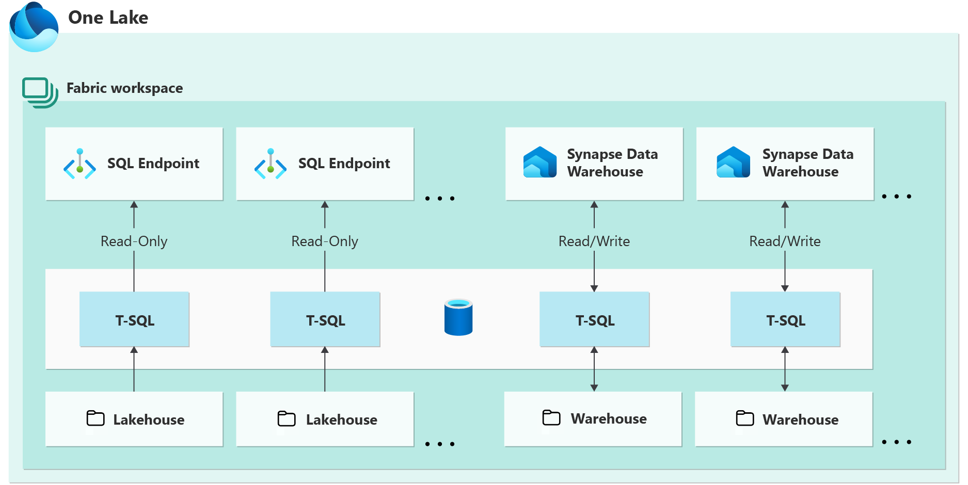
What is Fabric (Synapse) Data Warehouse?
Warehouse in Microsoft Fabric converges the world of data lakes and warehouses with a goal of greatly simplifying an organizations investment in their analytics estate
Data warehousing workloads benefit from the rich capabilities of the SQL engine over an open data format, enabling customers to focus on data preparation, analysis and reporting over a single copy of their data stored in their Microsoft OneLake
Fabric has two distinct data warehousing experiences: the SQL Endpoint of the Lakehouse and the Warehouse.
Fabric SQL Endpoint ≠ SQL Data Warehouse

Slide 3
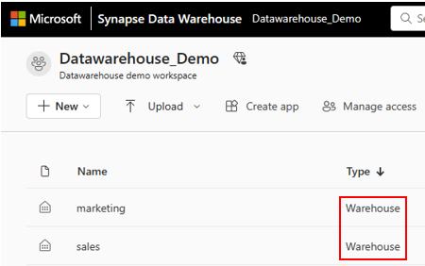
What is Fabric (Synapse) Data Warehouse?
Synapse Data Warehouse or Warehouse is labeled as 'Warehouse' under the ’Type’ column. A Warehouse supports transactions, DDL, and DML queries.
As opposed to SQL Endpoint, where tables and data are automatically created, you are fully in control of creating tables, loading, transforming, and querying your data in the data warehouse using either the Microsoft Fabric portal or T-SQL commands
The T-SQL Surface area is not 100% compatible with Synapse SQL Pools.*
*T-SQL surface area - Microsoft Fabric | Microsoft Learn

Slide 4
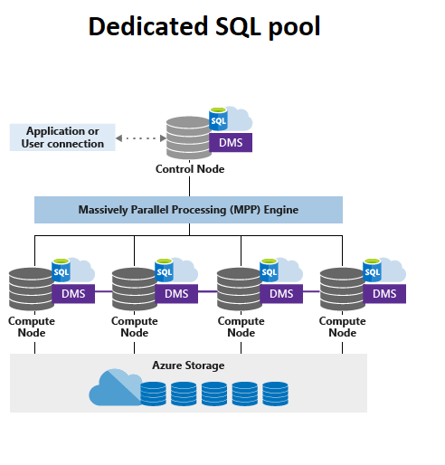
Fabric Data warehouse vs. Synapse SQL Pools
Fabric Datawarehouse is different from a Synapse SQL Pool. A SQL Pool is compute infrastructure with dedicated attached storage, where data is distributed across 60 distributions/nodes. Only the SQL Pool compute can read from the attached SQL Pool storage.
Fabric Data warehouse separates compute and storage entirely and relies on a serverless compute engine to run SQL statements. The Fabric Datawarehouse is essentially a logical data warehouse based on underlying parquet files.
Fabric data warehouse provides multi-table SQL ACID transactional guarantees similar to previous data warehousing expeirneces.

Slide 5
Data warehouse or Lakehouse?
 | Data warehouse | Lakehouse
Data volume | Unlimited | Unlimited
Type of data | Structured | Unstructured, semi-structured, structured
Primary developer persona | Data warehouse developer SQL engineer | Data engineer data scientist
Primary developer skill set | SQL | Spark(Scala, PySpark, Spark SQL, R)
Data organized by | Databases, schemas, and tables | Folders and files, databases, and tables
Read operations | Spark,T-SQL | Spark,T-SQL
Write operations | T-SQL | Spark(Scala, PySpark, Spark SQL, R)
Multi-table transactions | Yes | No
Primary development interface | SQL scripts | Spark notebooks, Spark job definitions
Security | Object level (table, view, function, stored procedure, etc.), column level, row level, DDL/DML | Row level, table level (when using T-SQL), none for Spark
Access data via shortcuts | Yes (indirectly through the lakehouse) | Yes
Can be a source for shortcuts | Yes (tables) | Yes (files and tables)
Query across items | Yes, query across lakehouse and warehouse tables | Yes, query across lakehouse and warehouse tables; query across lakehouses (including shortcuts using Spark)
Fabric decision guide - lakehouse or data warehouse - Microsoft Fabric | Microsoft Learn

Slide 6
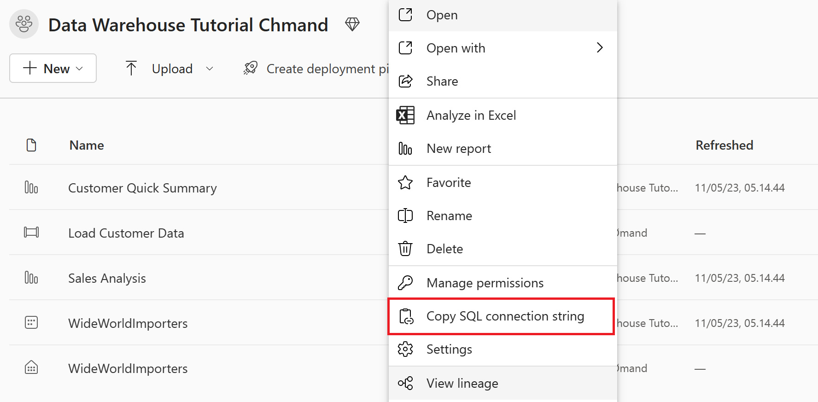
Fabric Data warehouse user experience
You can work with datawarehousing using the Fabric online experience or you can connect with tools like SSMS or Azure Data Studio using a SQL connection string

Slide 7
Time to try it out
Create a Warehouse.
Ingest data from source to the data warehouse dimensional model
Create tables in your Warehouse.
Load data with T-SQL with the SQL query editor.
Transform the data to create aggregated datasets using T-SQL.
Use the visual query editor to query the data warehouse.
Analyze data with a notebook.
Create and execute cross-warehouse queries with SQL query editor.

